Slide 1

Provide Insights to Management in Consumer Goods Domain
AD-HOC REQUESTS
Resume Challenge – 4 – SQL
Presented by : Lesie Fernandes

Slide 2
CONTENTS:
1
Company Overview
2
Challenges
AD-Hoc requests & Insights
3

Slide 3
Company overview:
Atliq Hardwares (imaginary company) is one of the leading computer hardware producers in India and well expanded in other countries too. They produce Mouse, Keyboard , PC and so on.
The company’s fiscal year starts from September to August.

Slide 4
CHALLENGE:
Management faced challenges as they couldn’t access insights needed to make smarter, data-driven decisions for their business.
To solve this issue, their Analytics Director decided to hire several Junior Data Analysts and assigned them the task of handling ad-hoc requests and providing valuable insights.

Slide 5

Requests - 1
Provide the list of markets in which customer "Atliq Exclusive" operates its business in the APAC region.
Query

Slide 6
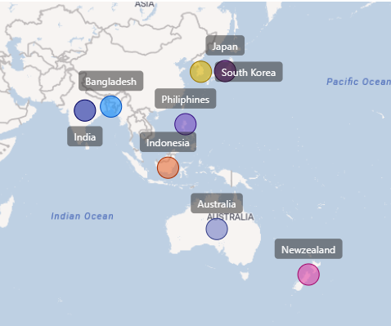

Output
AtliQ Exclusive operates in 8 countries in APAC region.

Slide 7
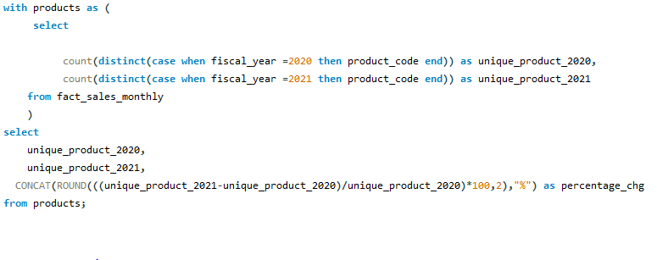
Requests - 2
What is the percentage of unique product increase in 2021 vs. 2020?
Query

Slide 8
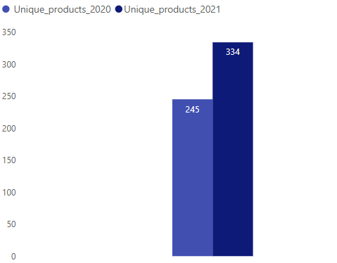

Output
36.33%
The total percentage of products increased from 2020 to 2021 is 36.33%.

Slide 9
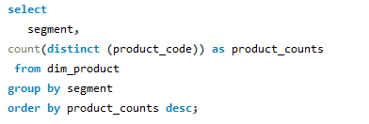
Requests - 3
Provide a report with all the unique product counts for each segment and sort them in descending order of product counts.
Query

Slide 10
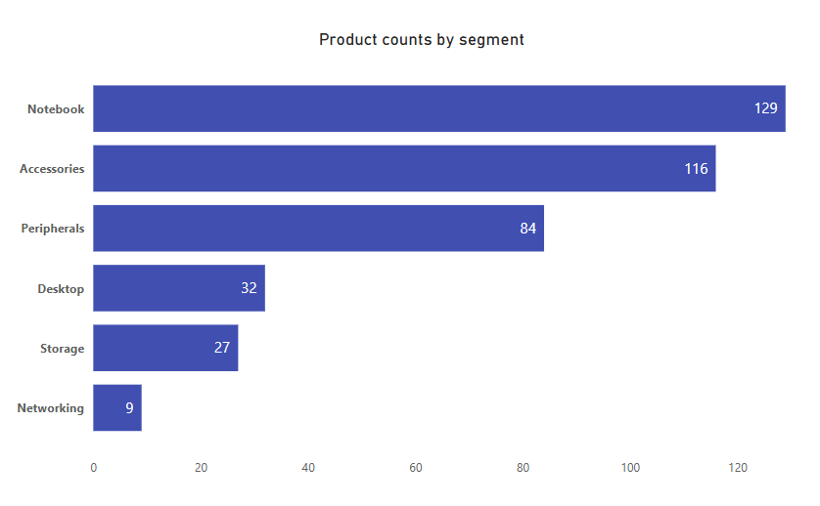
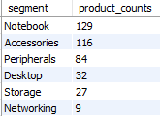
Output
In the segments Notebook, Accessories, and Peripherals total account for 82.87%, which is the highest. In contrast, Desktop, Storage, and Networking have the lowest product count at 17.13%.

Slide 11
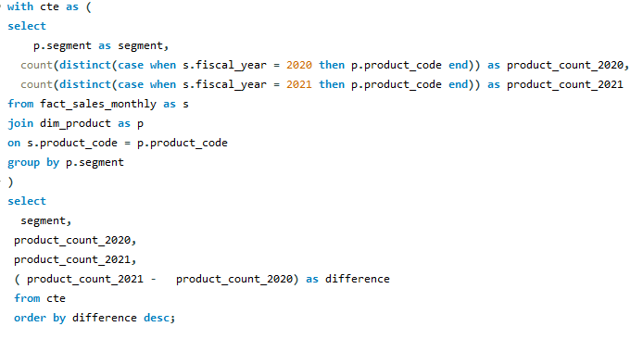
Requests - 4
Follow-up: Which segment had the most increase in unique products in 2021 vs 2020?
Query

Slide 12
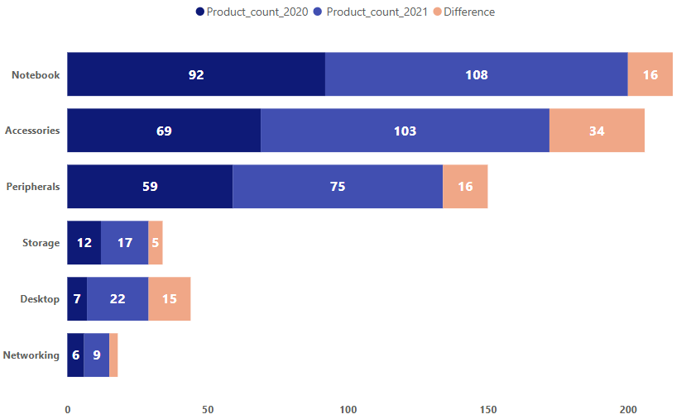
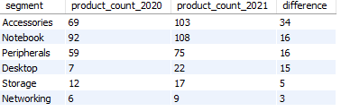
Output
The production of Accessories segment increased from 2020 to 2021 by a difference of 34.

Slide 13
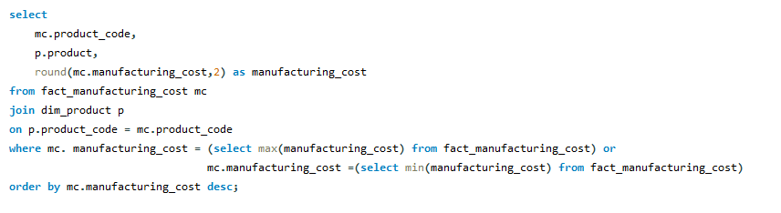
Requests - 5
Get the products that have the highest and lowest manufacturing costs.
Query

Slide 14

Output
$240.54
AQ HOME Allin 1 Gen 2
$0.89
AQ Master wired x1 Ms
The highest manufacturing costs is AQ Home Allin1 Gen 2 (Desktop) by $240.54/- and the lowest manufacturing costs is AQ Master Wired x1 Ms (Mouse) is $0.89/- .

Slide 15
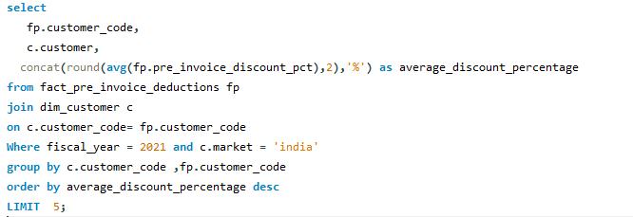
Requests - 6
Generate a report which contains the top 5 customers who received an average high pre_invoice_discount_pct for the fiscal year 2021 and in the Indian market.
Query

Slide 16
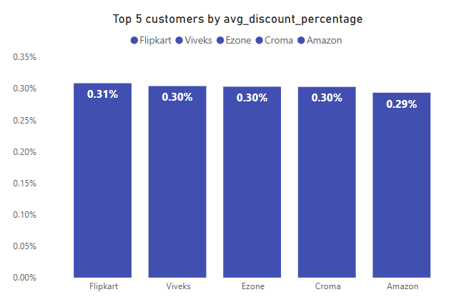
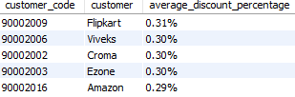
Output
In 2021, Out of top 5 customers Flipkart had the highest average pre invoice discount of 30.83%, while Amazon recorded at the lowest at 29.33%.

Slide 17
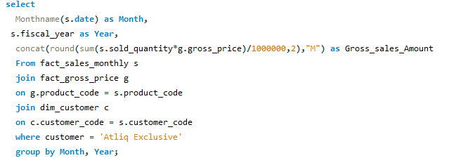
Requests - 7
Get the complete report of the Gross sales amount for the customer “Atliq Exclusive” for each month .
This analysis helps to get an idea of low and high-performing months and take strategic decisions.
Query

Slide 18
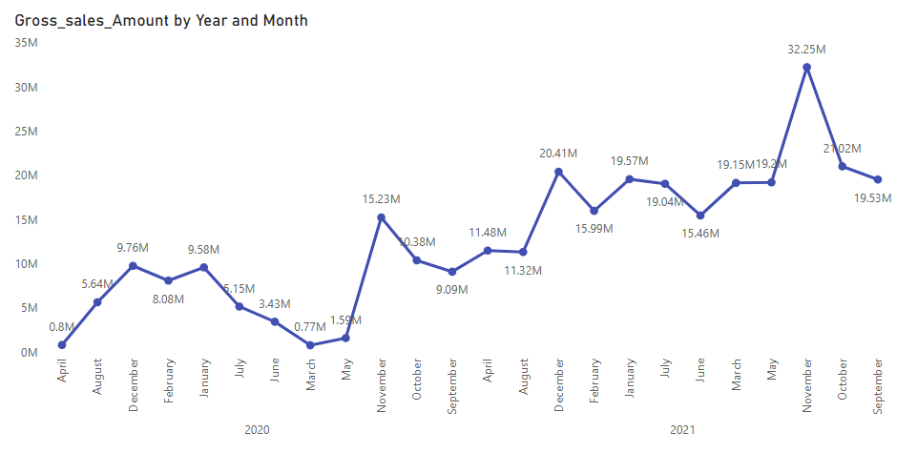
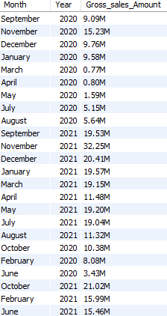
Output
Atliq recorded its lowest sales in the month of March-2020 i.e.0.77M due to the pandemic. While it surged in the November-2021 month i.e.32.25M.

Slide 19
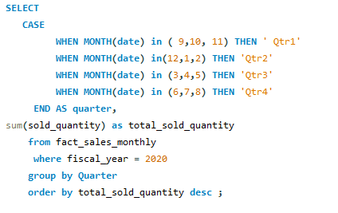
Requests - 8
In which quarter of 2020, got the maximum total_sold_quantity?
Query

Slide 20
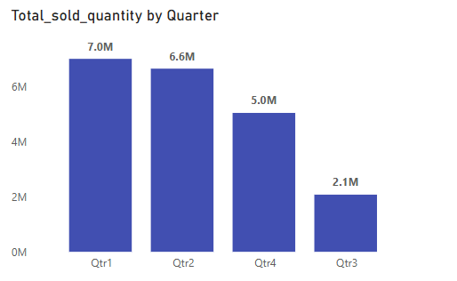

Output
Quarter 1 saw the highest sales at 7.0M units, while Quarter 3 dropped to 2.1M. Sales rebounded in Quarter 4, increasing by 3.0M units to reach 5.0M.

Slide 21
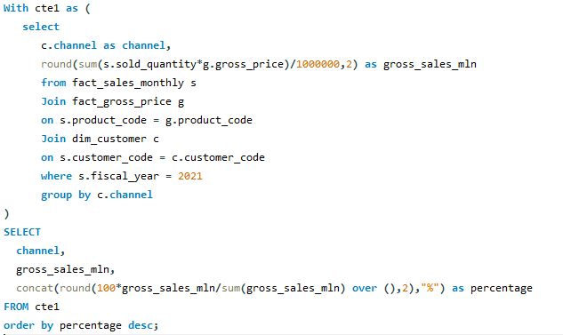
Requests - 9
Which channel helped to bring more gross sales in the fiscal year 2021 and the percentage of contribution?
Query

Slide 22
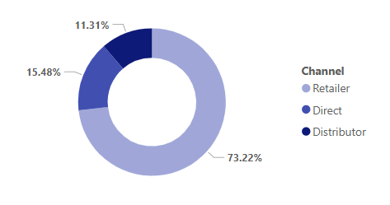

Output
Retailer contributed the most to gross sales with 73.22%.
While Distributor had the lowest contribution at 11.31%.

Slide 23
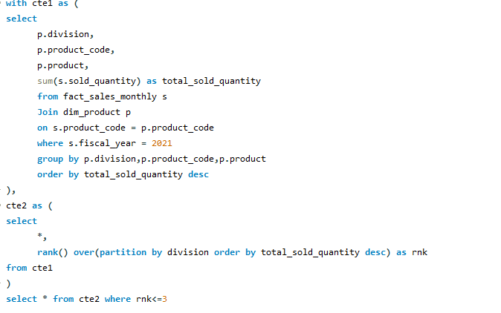
Requests - 10
Get the Top 3 products in each division that have a high total_sold_quantity in the fiscal_year 2021?
Query

Slide 24
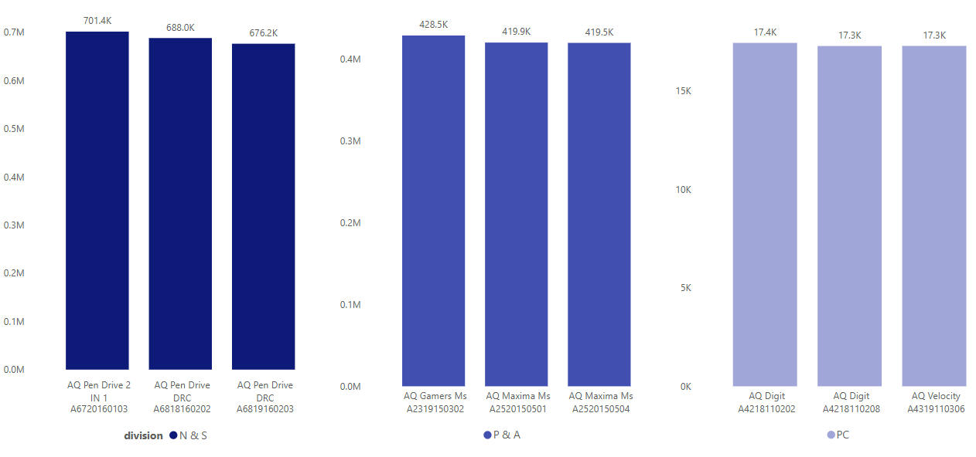
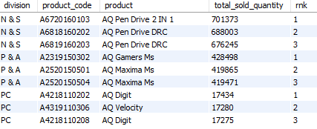
Output
In each division the top 3 products have a highest total sold quantity in F.Y.2021.

Slide 25
THANK YOU

